Slide 1

Comptron
The Ultimate Club Management App
Presenters:
Ovejit Das
ID:20232002010
Nowshin Tahmin Anika
ID:20232007010
Ishaq Rahman Rayem
ID:20232081010
APP DEVELOPER

Slide 2

Problem Statement
Inefficiencies in traditional campus event management systems hinder student engagement
Traditional campus event management faces significant challenges, including delays and errors caused by paper-based processes. This disconnects students from event administrators, making it difficult for students to discover and register for events, while admins grapple with inefficient manual management and poor communication.

Slide 3

Comptron Solution
Streamlining Campus Events with Flutter and MongoDB Technology
Comptron revolutionizes event management by providing a seamless platform for students and administrators. Built with Flutter for cross-platform accessibility and powered by MongoDB, the app simplifies event discovery, registration, and check-in. This modern solution enhances communication and engagement while easing administrative burdens, ensuring a more connected campus experience.

Slide 4
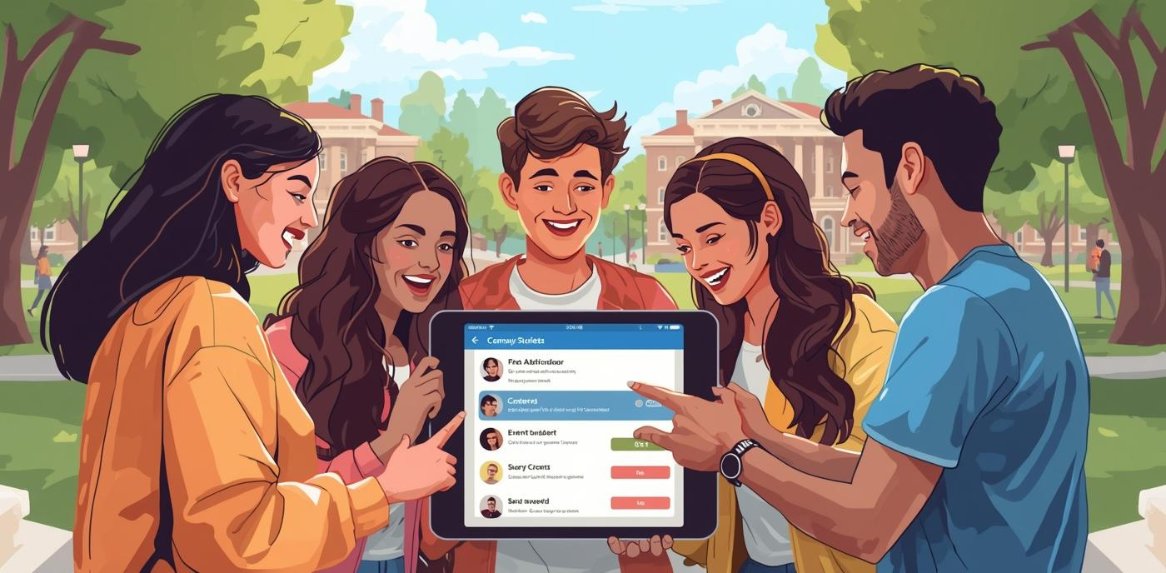
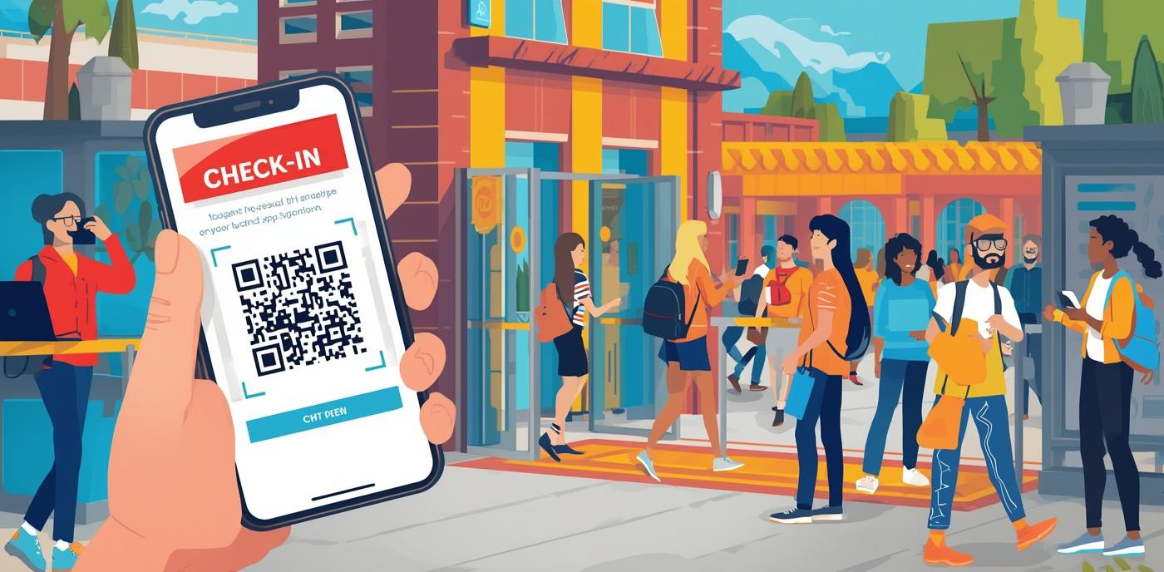
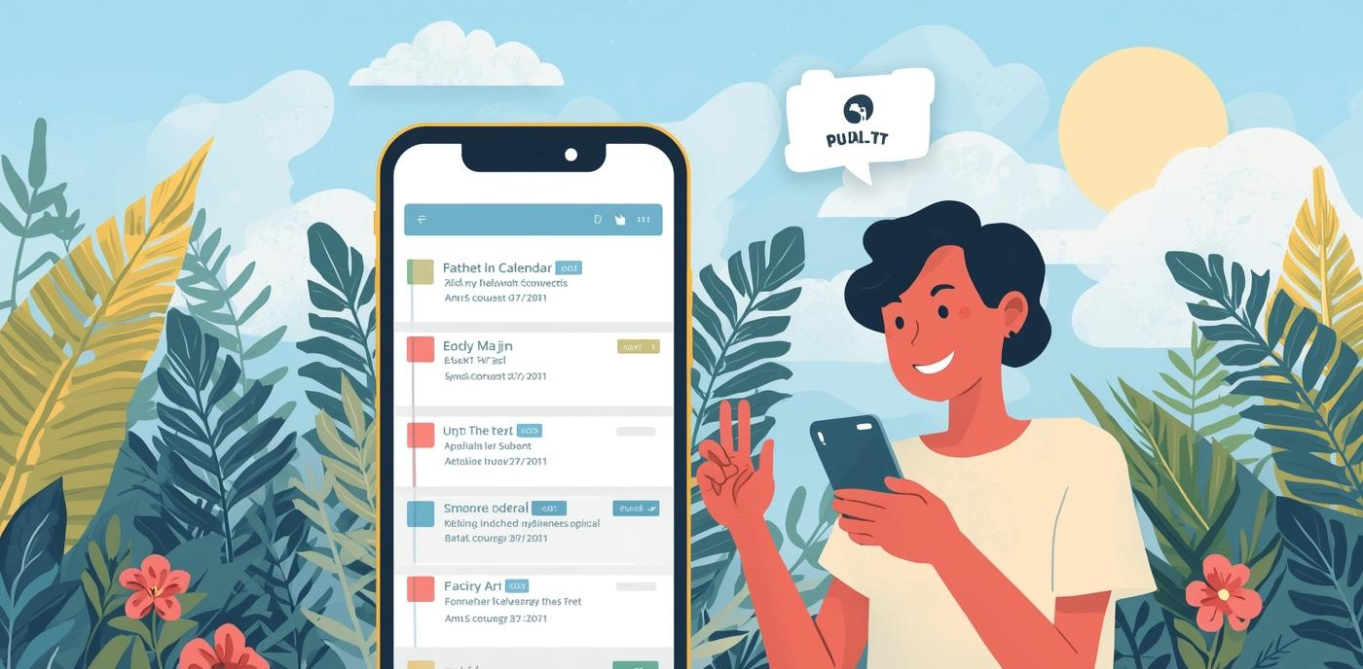
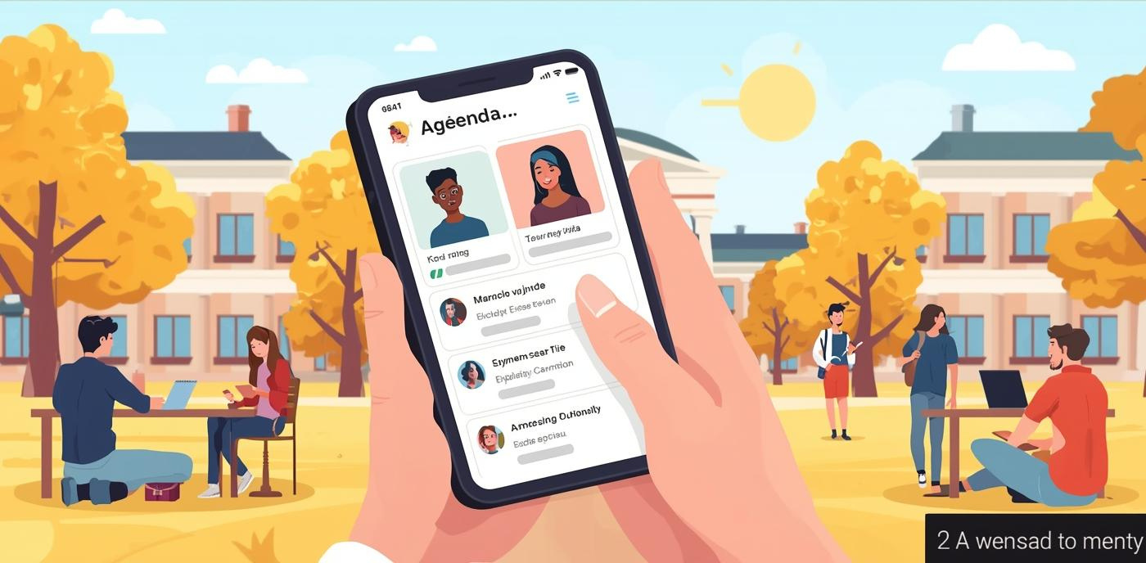
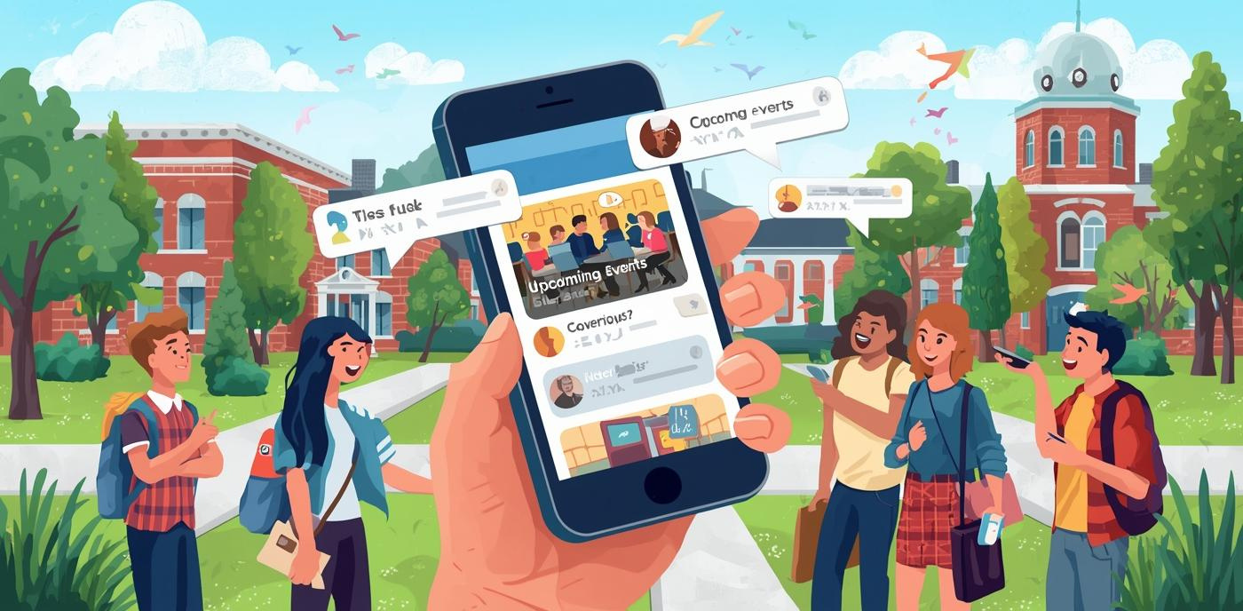
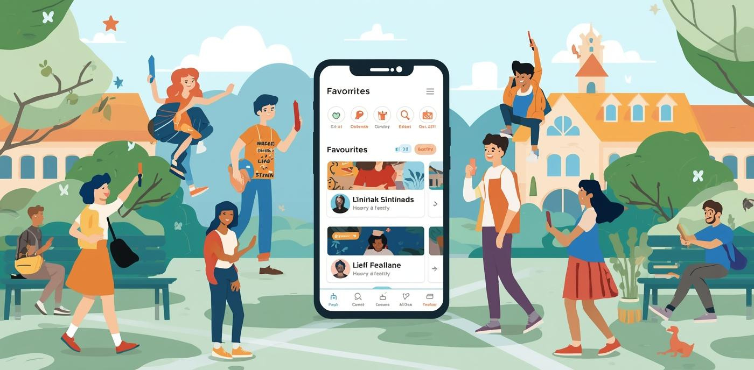
Event Registration
QR Code Check-In
Calendar Synchronization
Simple and quick process for users
Fast entry to events using code
Seamless integration with personal calendars
Push Notifications
Personal Agenda
Favorites
Instant updates about important events
Tailored event management for students
Quick access to preferred activities

Slide 5
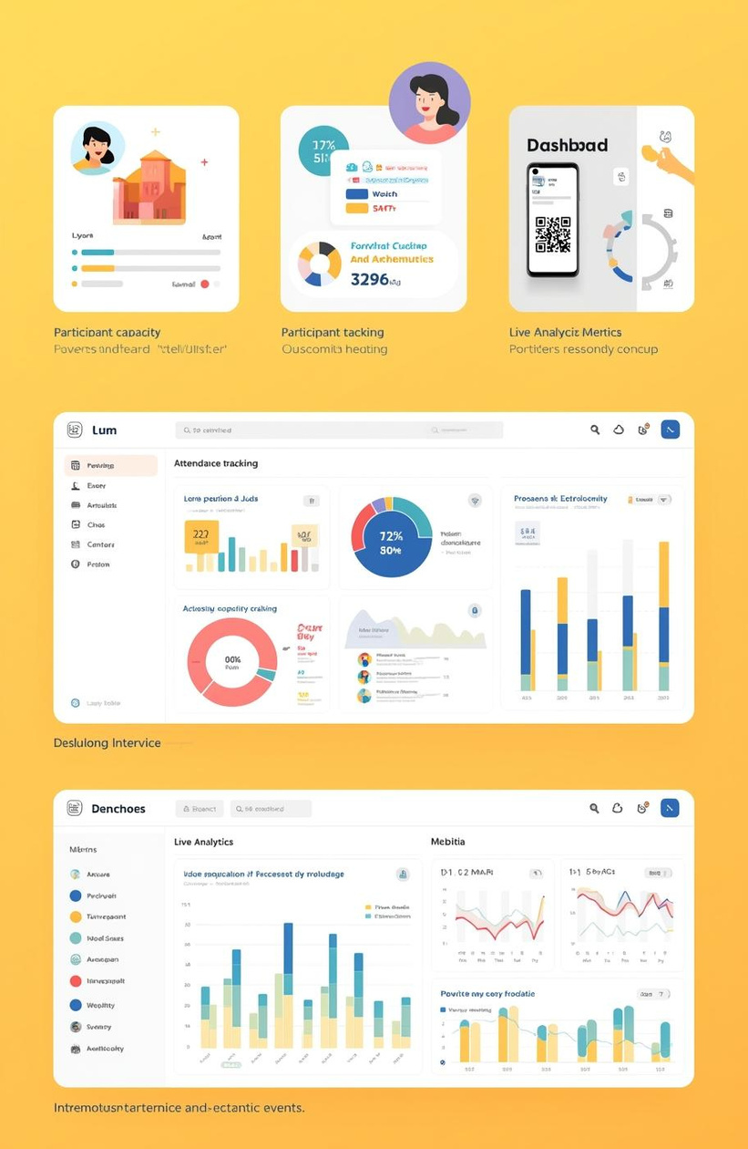
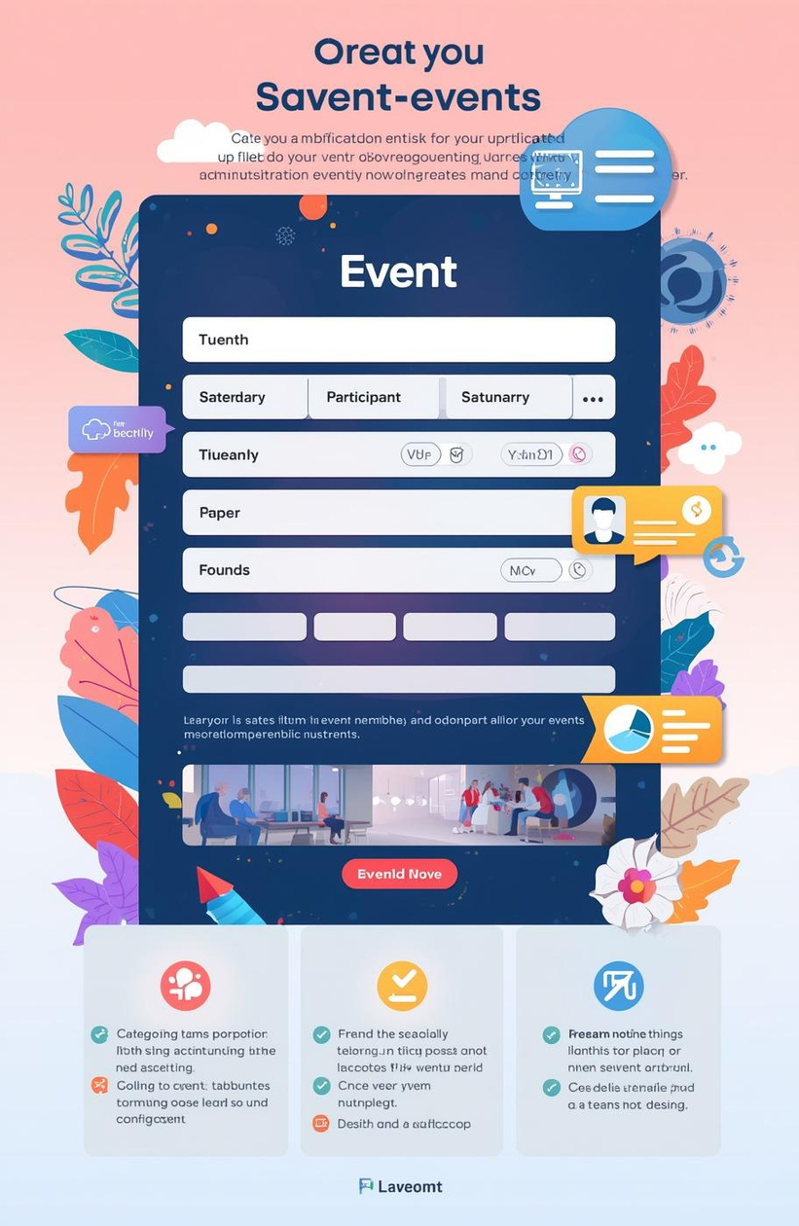
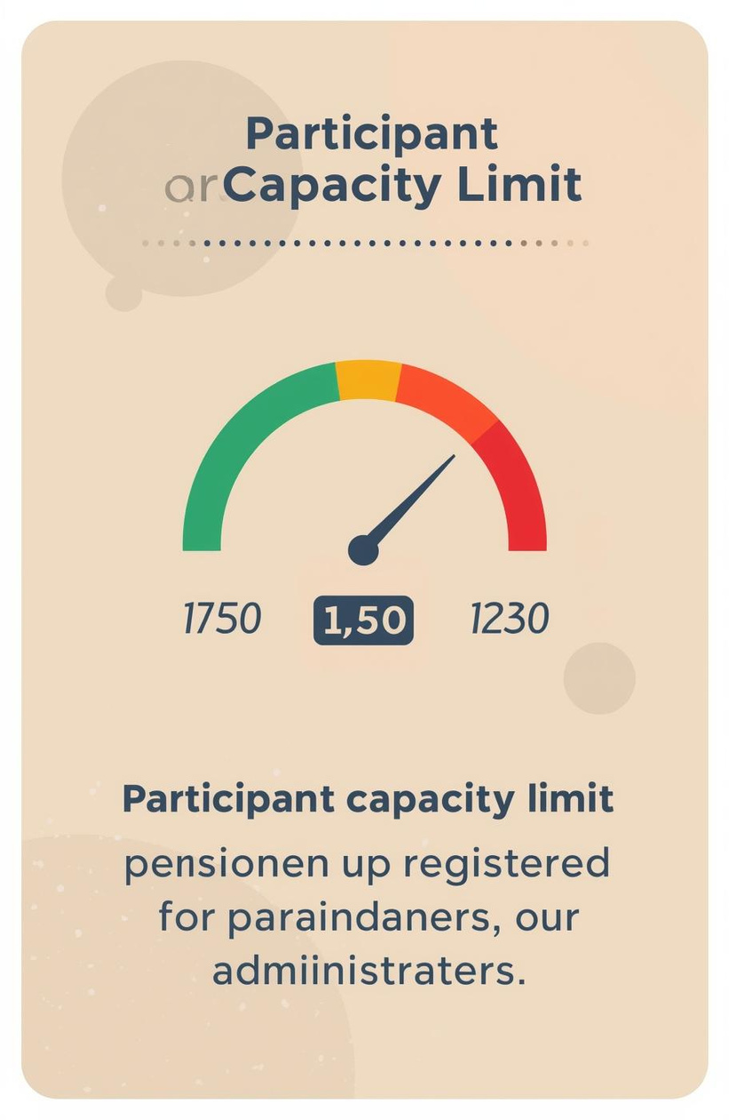
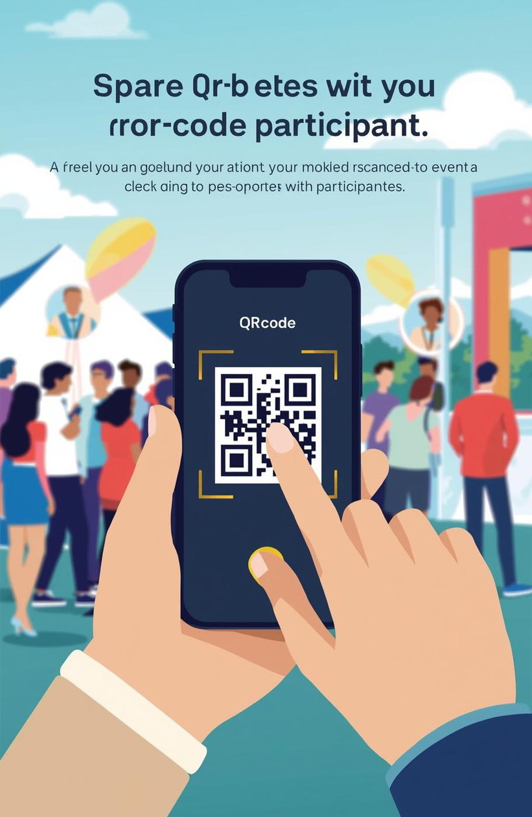
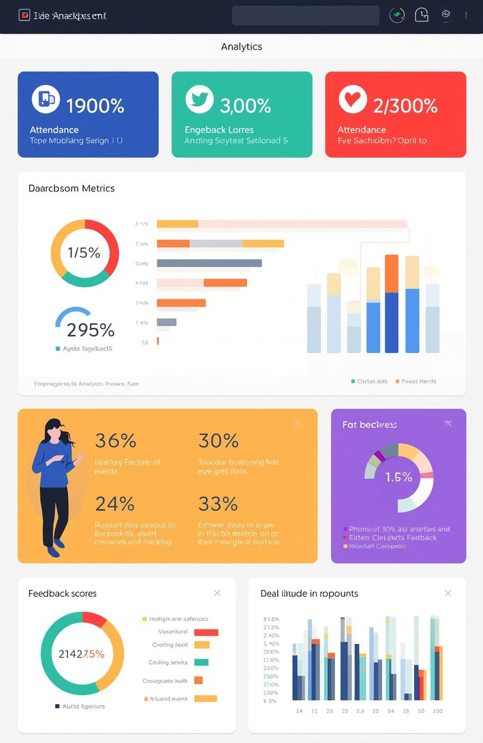
Event Creation
Capacity Limits
Waitlist Management
QR Code Scanning
Live Analytics
Easily create and manage all events
Set participant limits for each event
Automatically manage waitlisted participants
Streamline attendance with QR codes
Real-time insights into event performance
Key Admin Features Overview

Slide 6
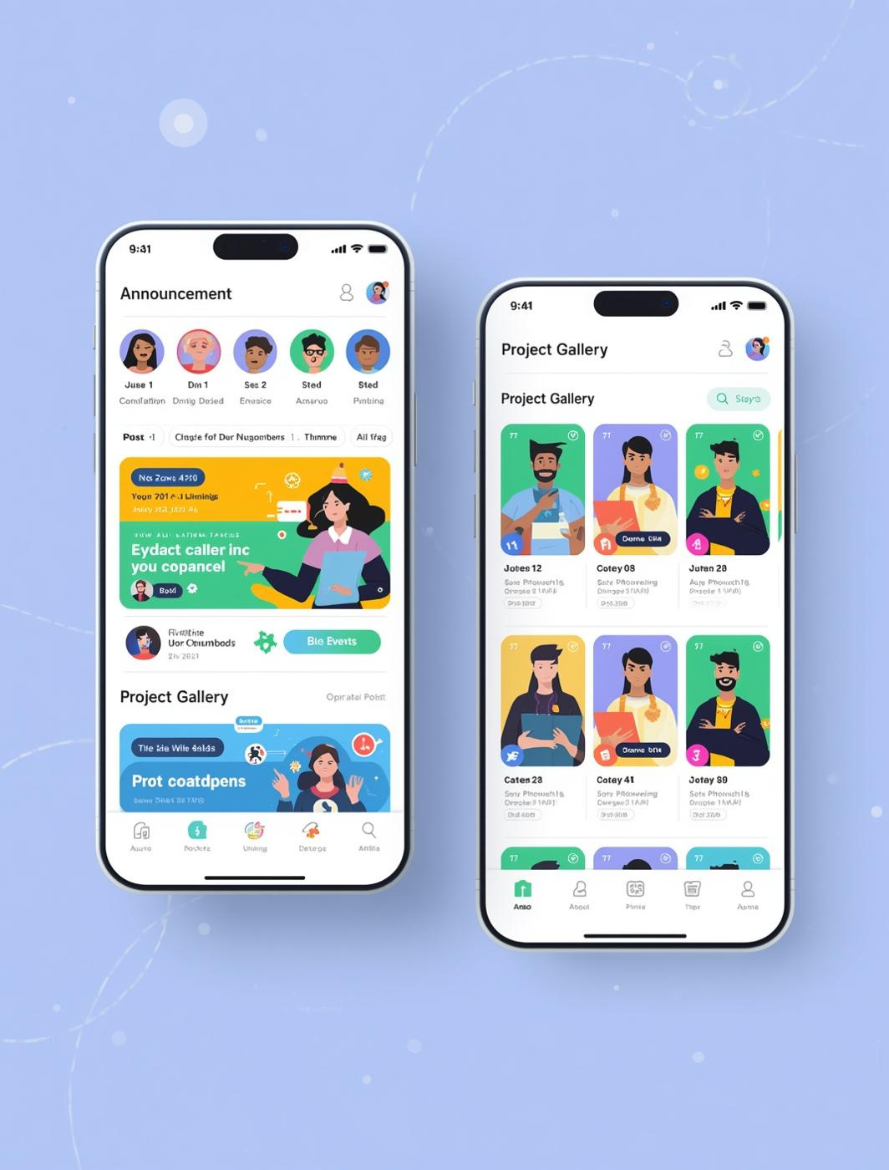
Announcements & Projects
Real-Time Event Updates and Resource Sharing for Students and Admins
Comptron enhances campus engagement by providing real-time event updates and a dedicated gallery feature for student projects. This allows students to showcase their work, receive feedback, and stay informed about campus activities. With admin approval, submissions ensure quality content, further fostering a vibrant university community.

Slide 7

Design & Impact
Enhancing Student Engagement through an Intuitive App Experience
Comptron is designed with modern accessibility principles to ensure a seamless user experience. By prioritizing user-friendly features and intuitive navigation, we aim to boost student participation in campus events. Our privacy-first approach safeguards user data, allowing students to connect and engage without concerns.

Slide 8

Thank you for joining
Your time means a lot.
Q&A
Ask anything. We’re here to help.

